Slide 1
Unit 2 Test Review
Intro to Programming in C#

Slide 2
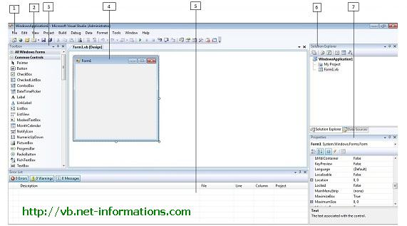
VS IDE=????

Slide 3
Variables
Type | Represents | Range | Default Value
 |  | True or False | False
byte | 8-bit unsigned integer | 0 to 255 | 0
char | 16-bit Unicode character | U +0000 to U +ffff | '\0'
decimal | 128-bit precise decimal values with 28-29 significant digits | (-7.9 x 10²⁸ to 7.9 x 10²⁸) / 10^{0 to 28} | 0.0M
 | 64-bit double-precision floating point type | (+/-)5.0 x 10⁻³²⁴ to (+/-)1.7 x 10³⁰⁸ | 0.0D
float | 32-bit single-precision floating point type | -3.4 x 10³⁸ to + 3.4 x 10³⁸ | 0.0F
 | 32-bit signed integer type | -2,147,483,648 to 2,147,483,647 | 0
long | 64-bit signed integer type | -9,223,372,036,854,775,808 to 9,223,372,036,854,775,807 | 0L
sbyte | 8-bit signed integer type | -128 to 127 | 0
short | 16-bit signed integer type | -32,768 to 32,767 | 0
uint | 32-bit unsigned integer type | 0 to 4,294,967,295 | 0
ulong | 64-bit unsigned integer type | 0 to 18,446,744,073,709,551,615 | 0
ushort | 16-bit unsigned integer type | 0 to 65,535 | 0

Slide 4
Strings=???
Objects=???

Slide 5
Using Objects
Some are automatically constructed
Examples:?????,?????,?????
Some you need to make yourself
Examples: ????,????
Majority of objects have ????? and ????? which are accessible via the ????? operator
Examples: Math. ?????(), MessageBox. ?????(),
Convert. ?????() etc.

Slide 6
Creating Random Numbers
In C# you first need to create the Random object and assign it to a variable
Random r= ????? Random();
Next, you use the objects available functions to create a range of possible numbers
The example we used was the ????? function
Some functions have parameters which are descriptions of data that it needs to do its job.
The Next function needs a ????? and a ????? number and will generate/return a random number between min and max
Example:
Random r =new Random();
int x=r.Next(2,20);//x contains anumber between 2 and 19

Slide 7
Properties and Events
You create GUIs in VS GUIs are made up of controls/components/objects
These have properties and events
Properties define a components ????? and potential ?????
Property values can be either ?????, ?????, ????? or ?????
Events are actions that a component can be a recipient of ex. ?????, ?????, ?????, ????? etc.

Slide 8
Properties
Properties can be assigned in the design window or in code
Properties can be assigned values that match data type if types do not match you must perform a conversion
Ex. btnWidth.Width= ?????(txtWidth.Text);
Values can be assigned through literal or referenced values
Ex. btnWidth.Width= ?????;// ?????
Or
btnWidth.Width= ?????;// ?????

Slide 9
Events
Events are set up through the VS IDE
VS creates an event function for each event
The name of the component and the event are listed in the event function
private void ?????(object sender, EventArgs e) { //code inside event... }

Slide 10
Decision Making
Sometimes referred to as selection
The general format is as follows:
if(condition)
{}
else if(condition)
{}
else if(condition)
{}
.
.
.
else
{}

Slide 11
A selection statement can have as many else ifs as ?????
A selection statement can only have ????? else and it can only be located at the end
Additional else ifs or an else is ?????
No other conditions are checked once the first evaluates to ?????

Slide 12
Conditons
These form the actual decisions made in a program
They evaluate to ????? or ????? only
Can be built using conditional or comparison operators (?????, ?????, ?????, ?????, ?????, ?????) and logical operators (?????, ?????, ?????)

Slide 13
Comparing Strings
The ????? numbers are used to compare strings
Lowercase letters have a ????? ASCII value than uppercase
“cat”>”Cat” is ?????

Slide 14
Logical Operators
&&= ?????
true && true= ?????
true && false= ?????
false && false= ?????
||= ?????
true || true= ?????
true || false= ?????
false || false= ?????
!= ?????
!true= ?????
!false= ?????

Slide 15
Repetition/Looping
Loops are used to iterate blocks of code repeatedly in programming
2 main types:1. counted or ????? loops and 2. ????? loops (????? and ?????)

Slide 16
For Loops
for(initialize index;index condition;index increment/decrement){body}
Ex.
int c=10;
for(int x=0;x<5;x++)
{//c=c+5;}

Slide 17
Conditional Loops
Used when number of iterations is not known i.e. it is conditional on some value the programmer does not know
Example:
Random r=new Random();
int card1=r.Next(1,53);
do{
card2=r.next(1,53);//need to draw at least one time so a post condition loop is required
}while(card2==card1);
//Keep drawing a random card while it matches the first
Card. When they don’t match, move on. This way we make sure we don’t draw two of the same cards. We don’t know how many draws this will take and so we need a conditional, rather than a counted loop.

Slide 18
Two Types of Conditional Loops
Pre Condition | Post Condition
while(condition){} | do{}while(condition);
Min 0 iterations | Min 1 iteration

Slide 19
Miscellaneous
% means ?????
Math.abs () is used to ??????
* means to ??????
/ means to ??????
Radio buttons are different from checkboxes in that they ??????
To check the state of either use their ????? property

Slide 20
Final Notes
You are allowed a 8.5x11 support sheet for the test (both sides).
Make sure to bring pencils and erasers.
No calculators are required.
Good Luck!

